Slide 1
Retailing is vital link in B5
Why retailing is impt
.
Retailing
Attitude
Goals
Prospecting
Follow Up

Slide 2
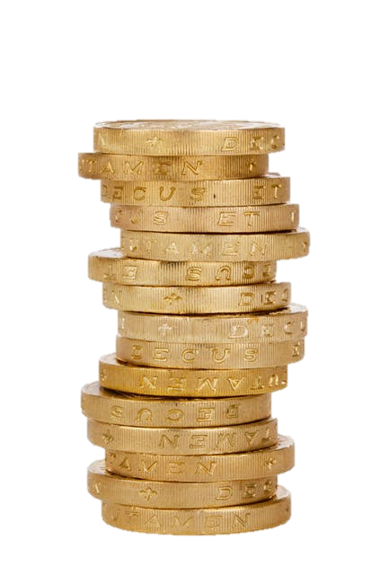
Retailing is for...
Cashflow
& BVs/IBVs

Slide 3
Objective of Retailing is solving their PROBLEM
Matching Products to People
& People to Products

Slide 4
Belief
Attitude
Retail Diagnostic Tool
Result
Action

Slide 5
Believe in your retail potential
Notes:
Work on your belief

Slide 6
Notes:
and how to do that??
You all know this movie right? Who has watched it? Was it good? Did you tell somebody else?
Key point is Be a product of the product

Slide 7
“Experiential” Retailing
SHOP.COM
Use Learn Share
SHOP.COM
SHOP.COM

Slide 8
Use Learn Share

Slide 9
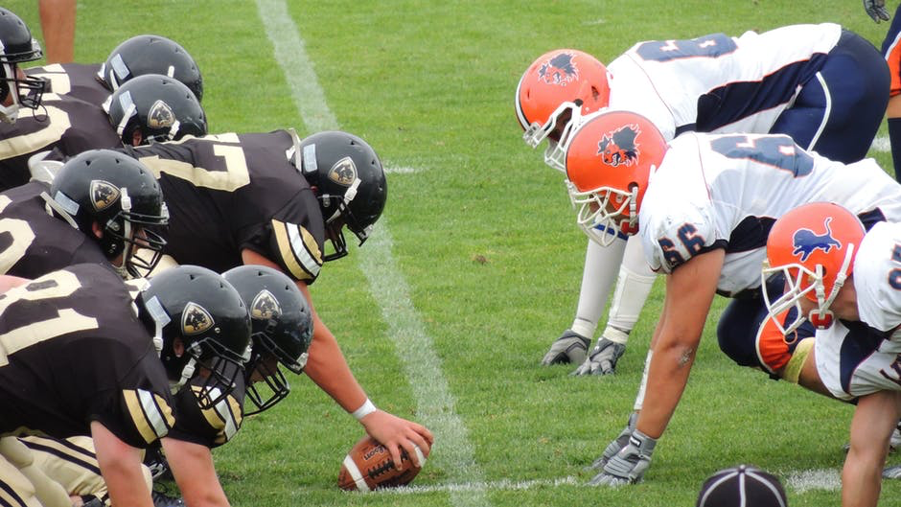
Teamwork makes Retailing work
Notes:
Its about teamwork

Slide 10
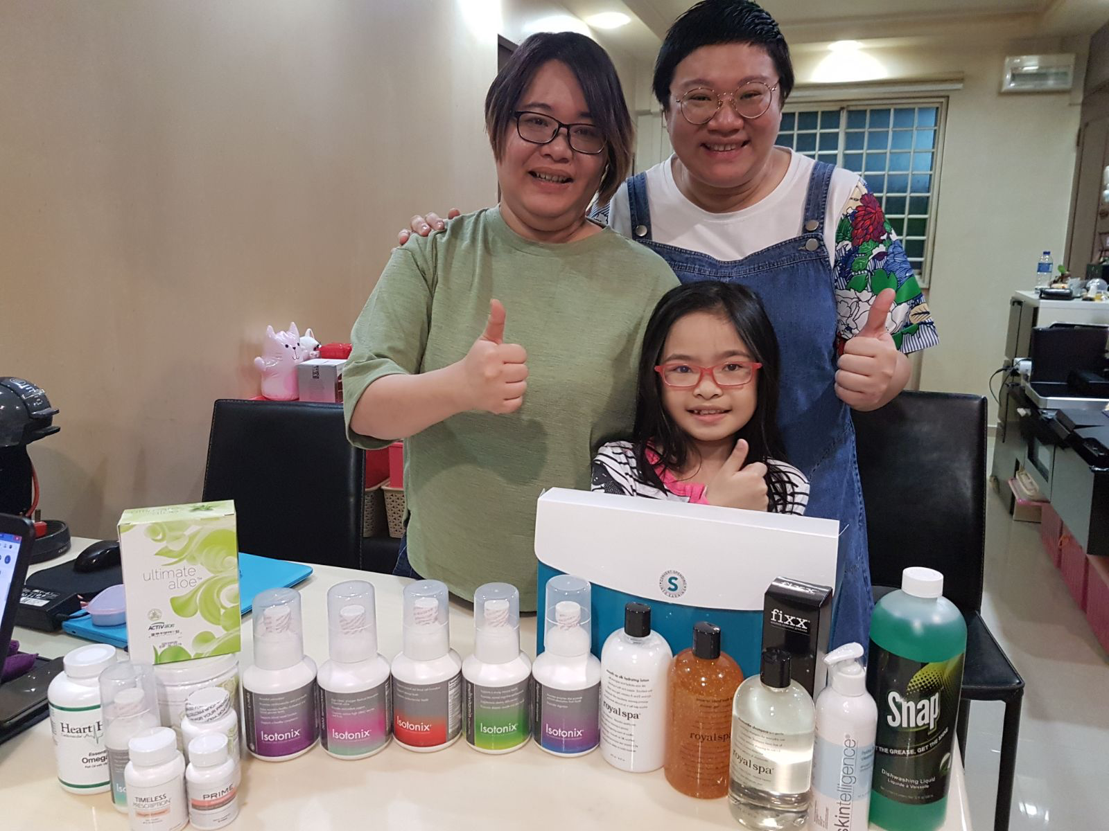
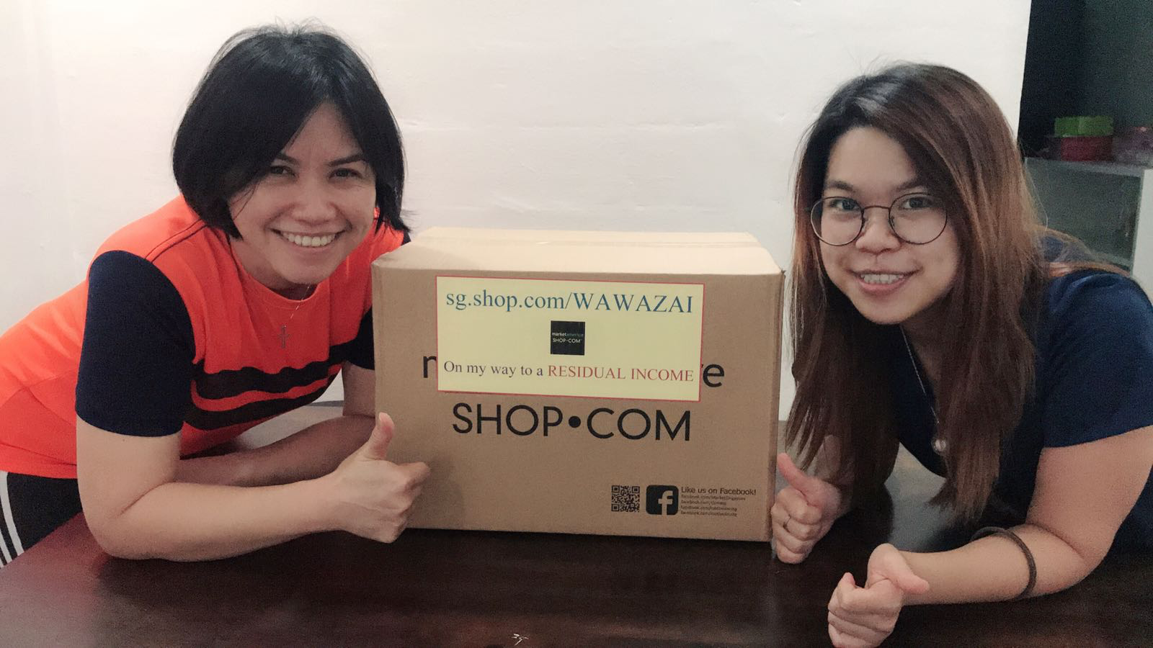
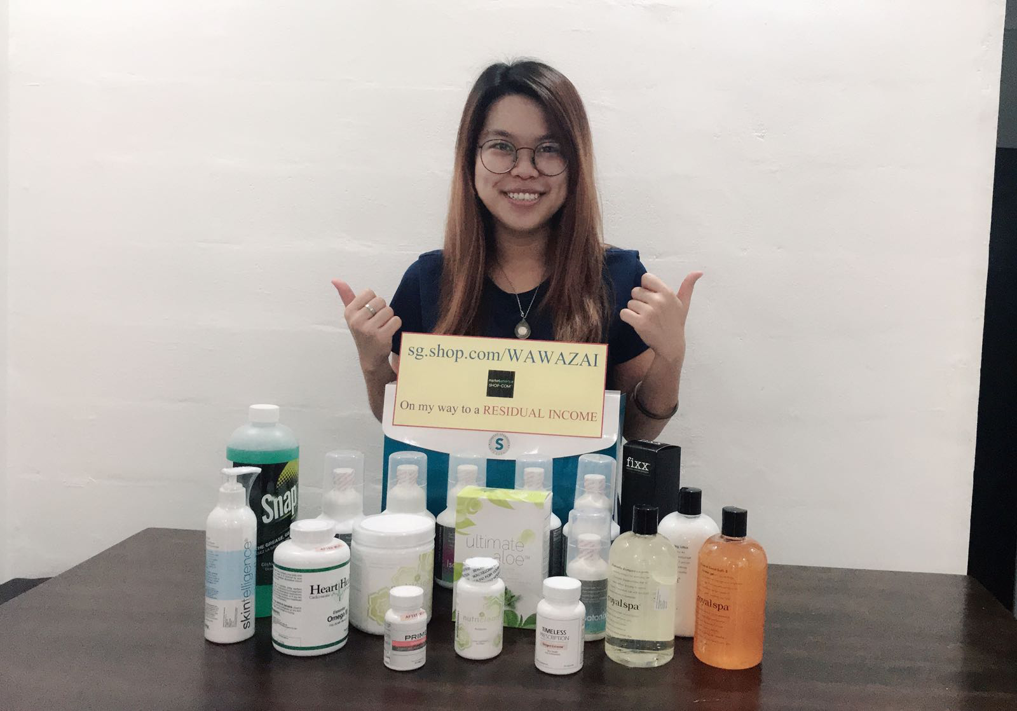
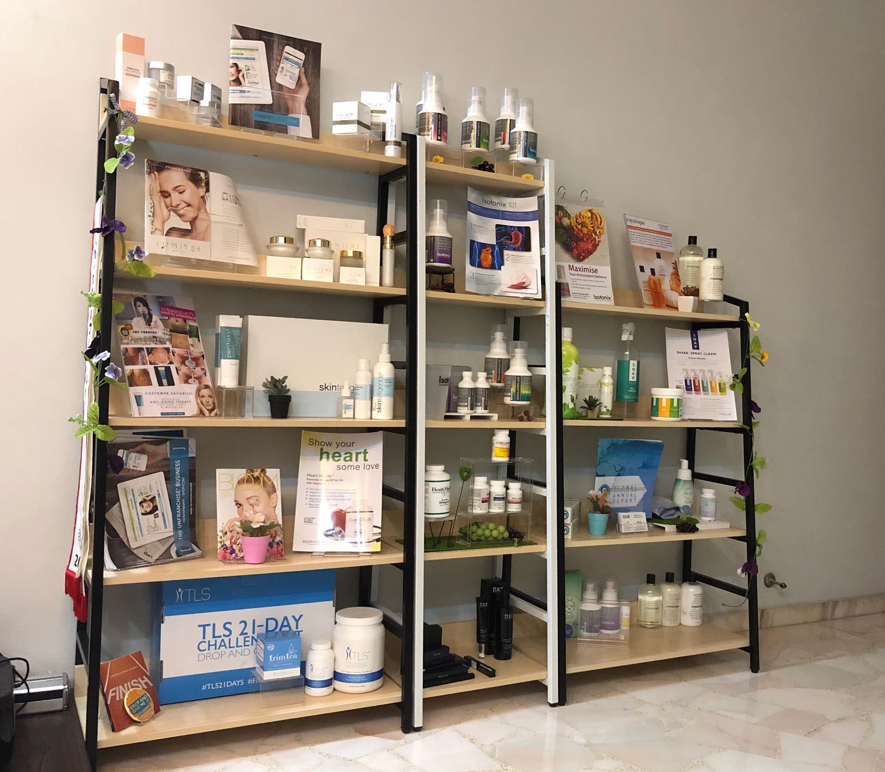
“OPEN” BOX is a great way to start
& Duplicate

Slide 11
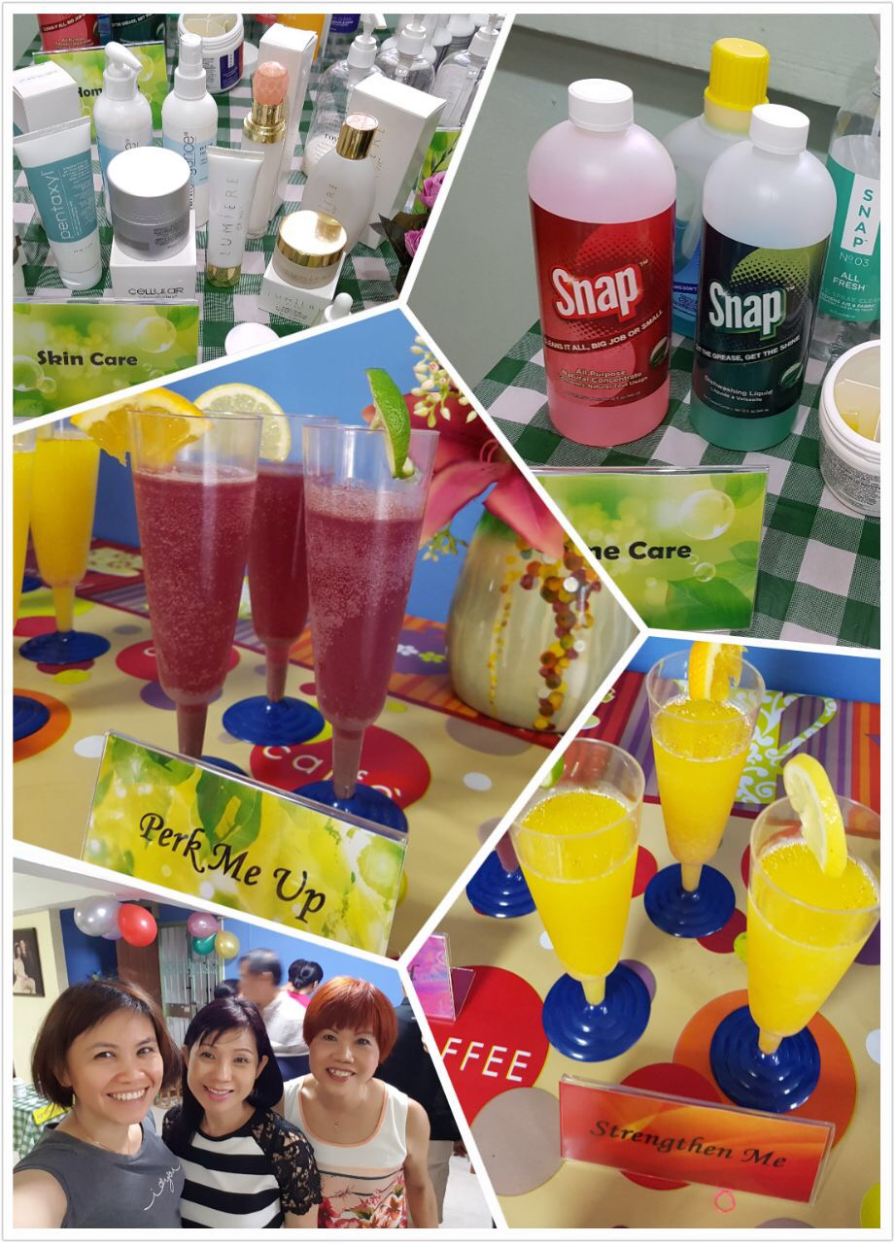
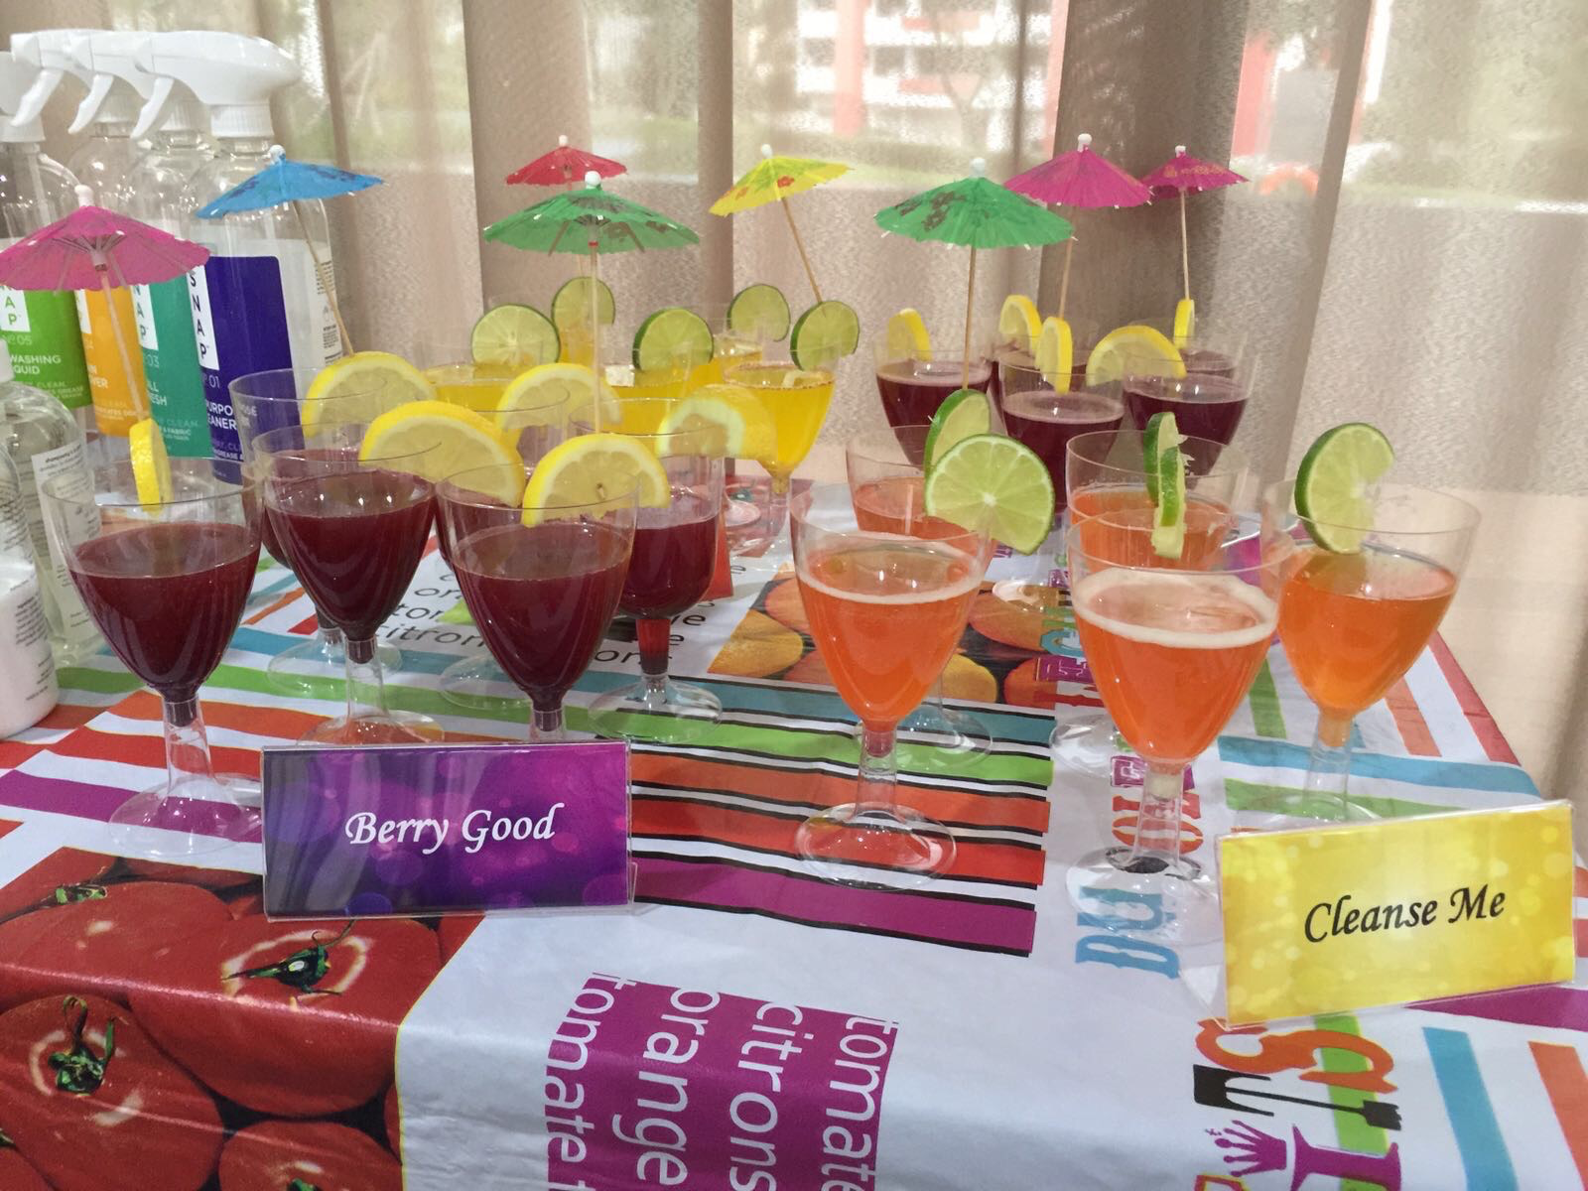
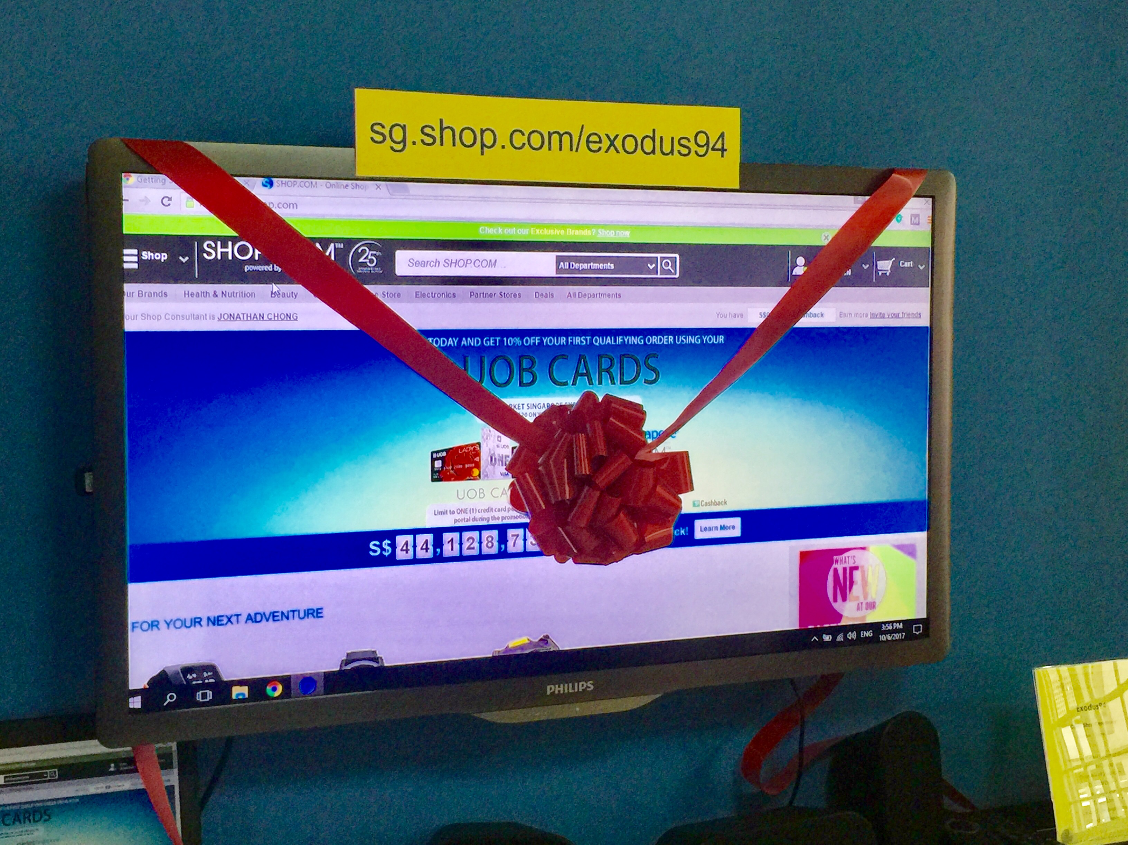
“OPEN” Shops are fun!
Be creative!

Slide 12
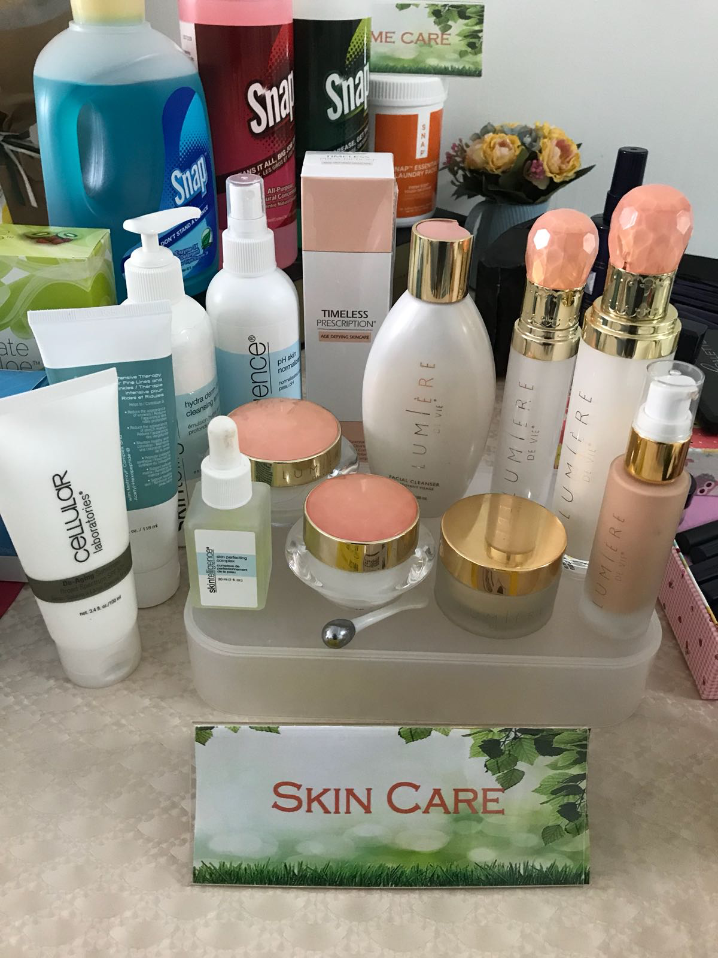
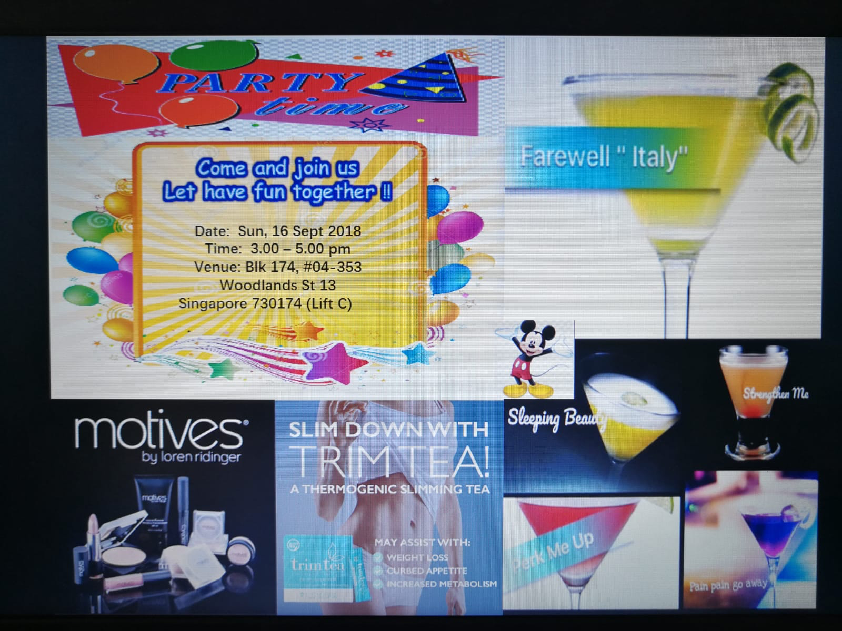
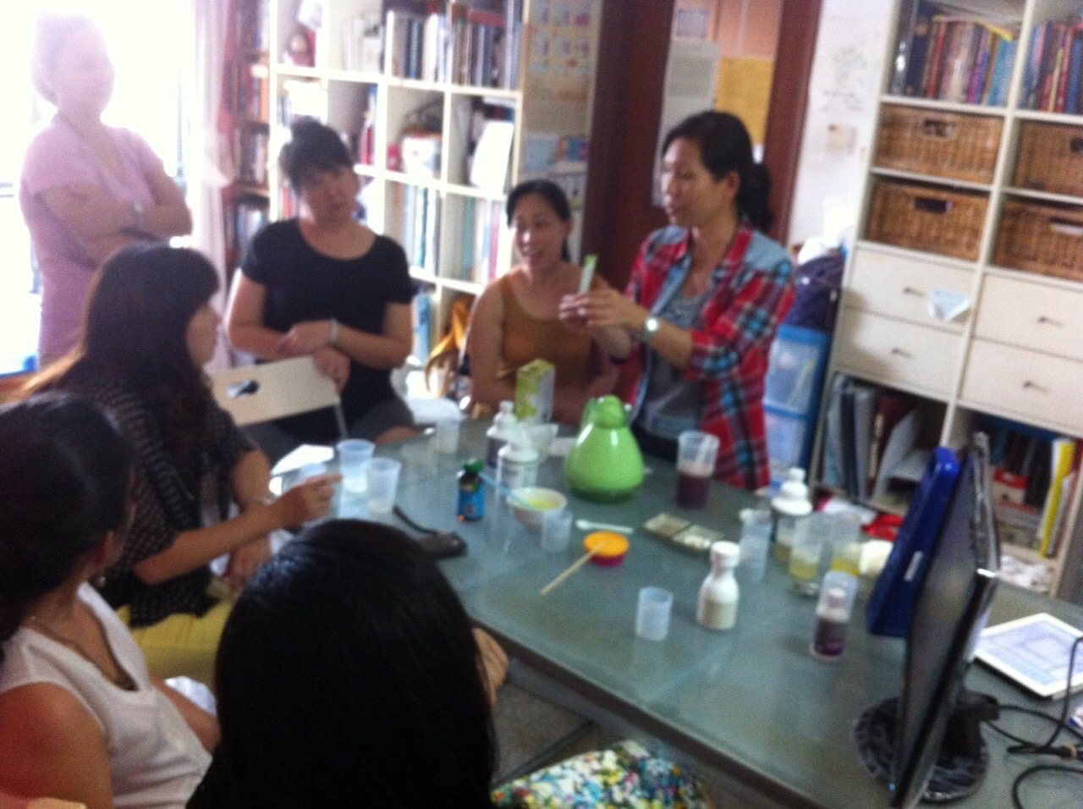
“OPEN” House
HBPs

Slide 13
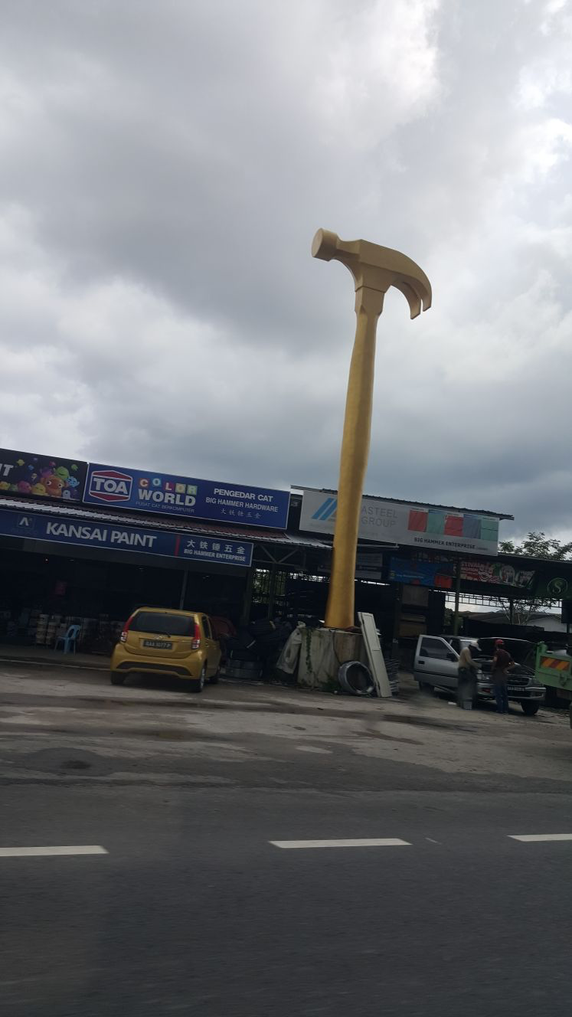
IF THE ONLY TOOL YOU HAVE IS A HAMMER, YOU TEND TO SEE EVERY PROBLEM AS A NAIL
- Abraham H Maslow

Slide 14
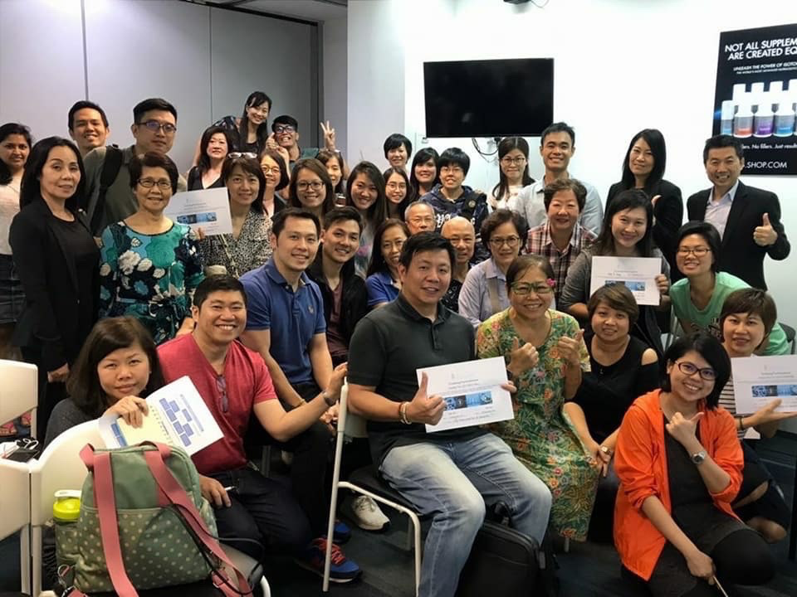
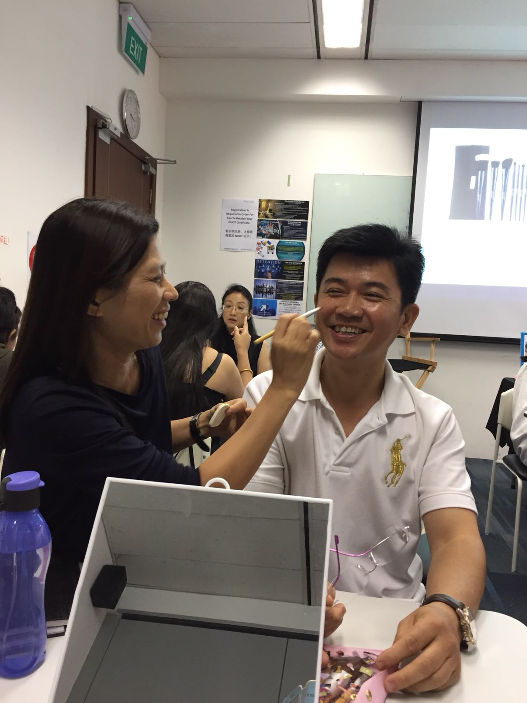
Leverage GMTSS

Slide 15
Retailing is vital link in B5
Why retailing is impt
.
Retailing
Attitude
Goals
Prospecting
Follow Up

Slide 17
ZERO to 500 BV
Product of the Product
Belief
Knowledge
Retail

Slide 18
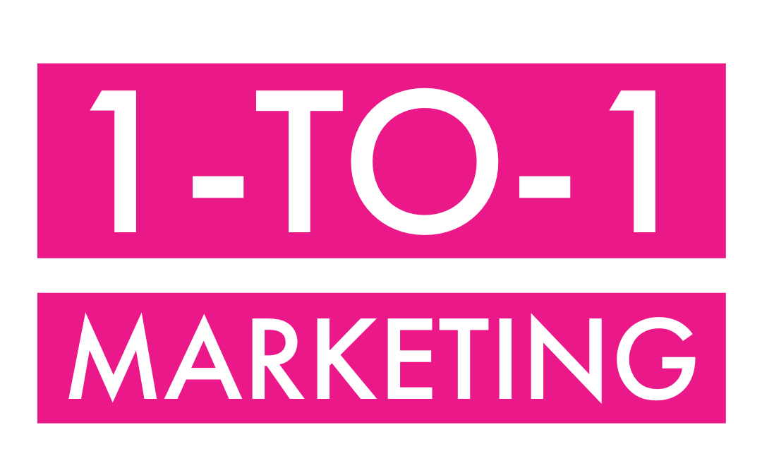
THE 3C’s APPROACH
Care for them
Show Concern
Be Genuinely Curious

Slide 19
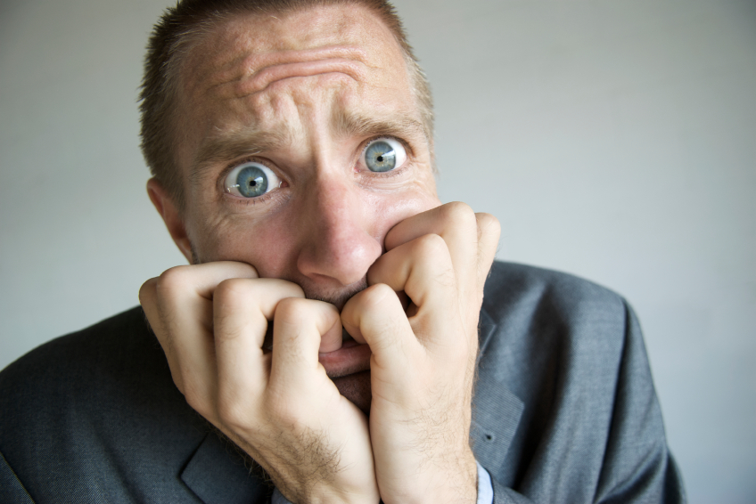
Presented By:
Jesscia Lee
Retailing

Slide 20
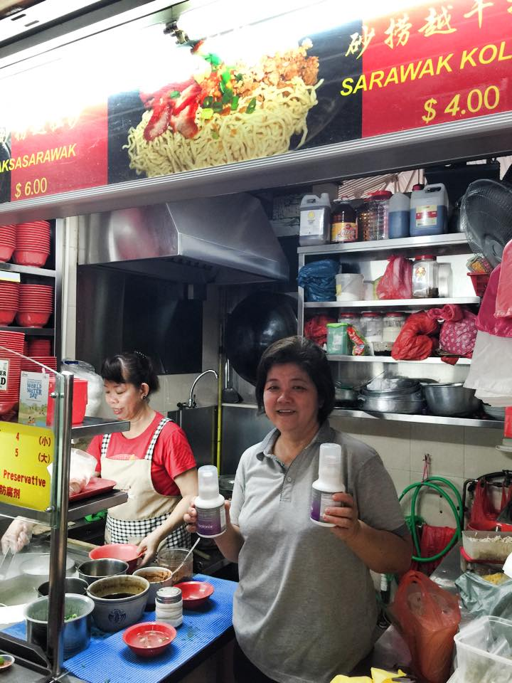
STRANGERS
Observation & Direct Approach
Outcome : Yes/No

Slide 21
Warm Groups
Harder & take longer time
Intentionally create awareness
Outcome: Repeated Sale / Retail to Recruit

Slide 22
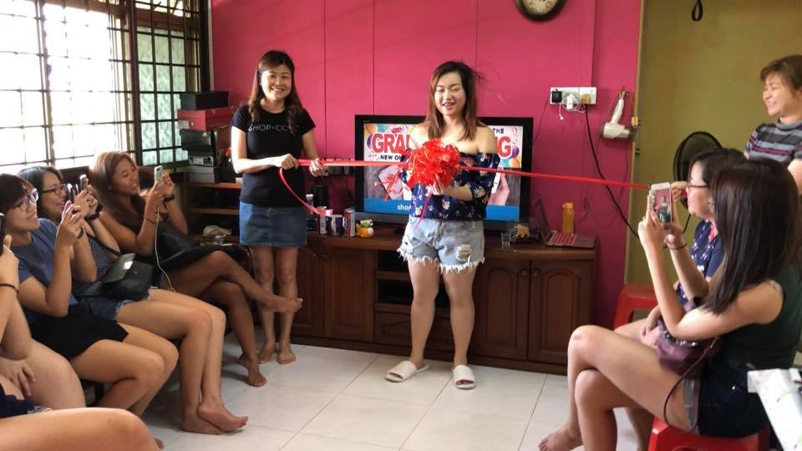
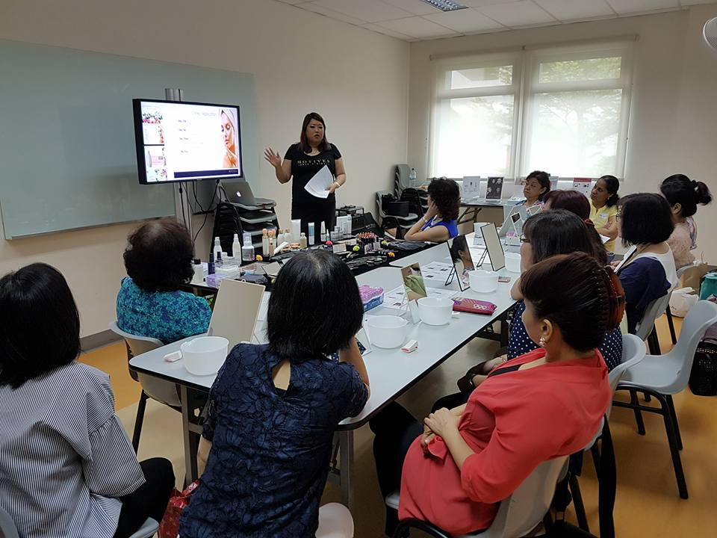
GROUP
events
Home parties
Collaborate with external organisations

Slide 23
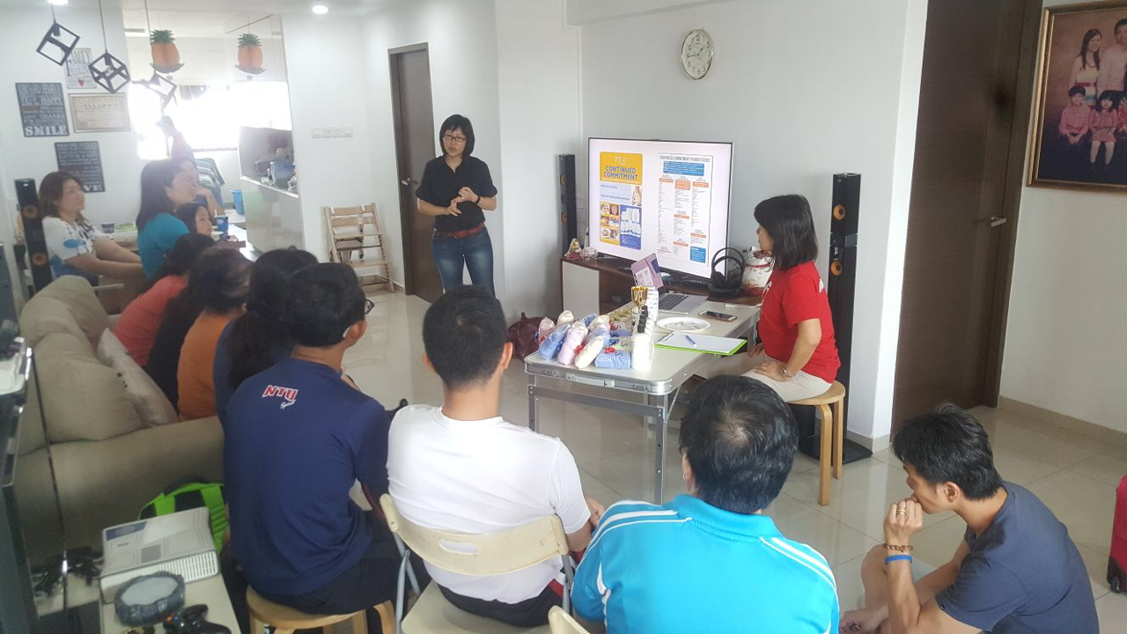
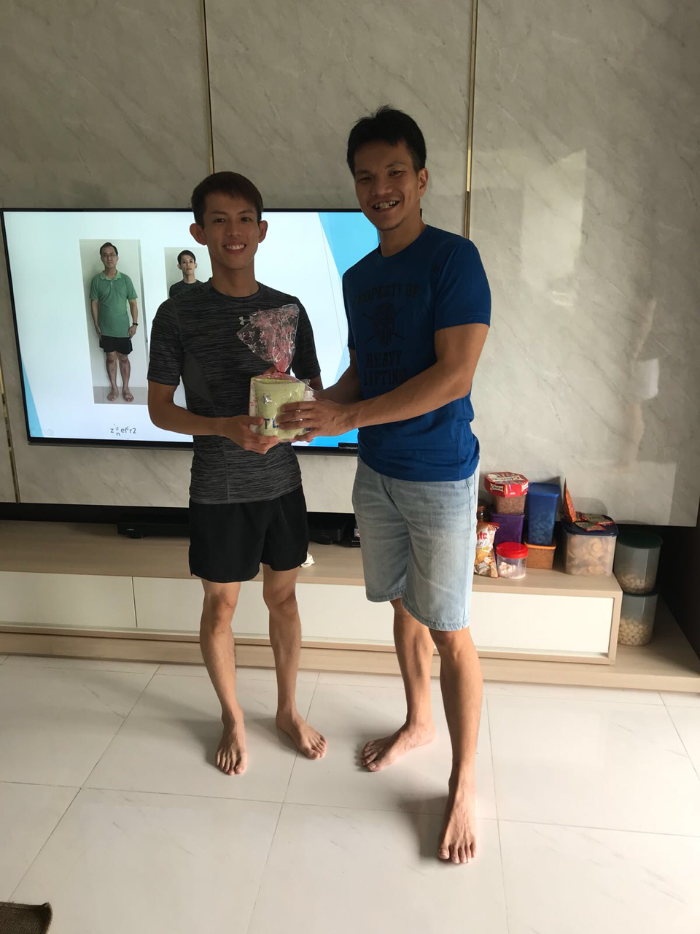
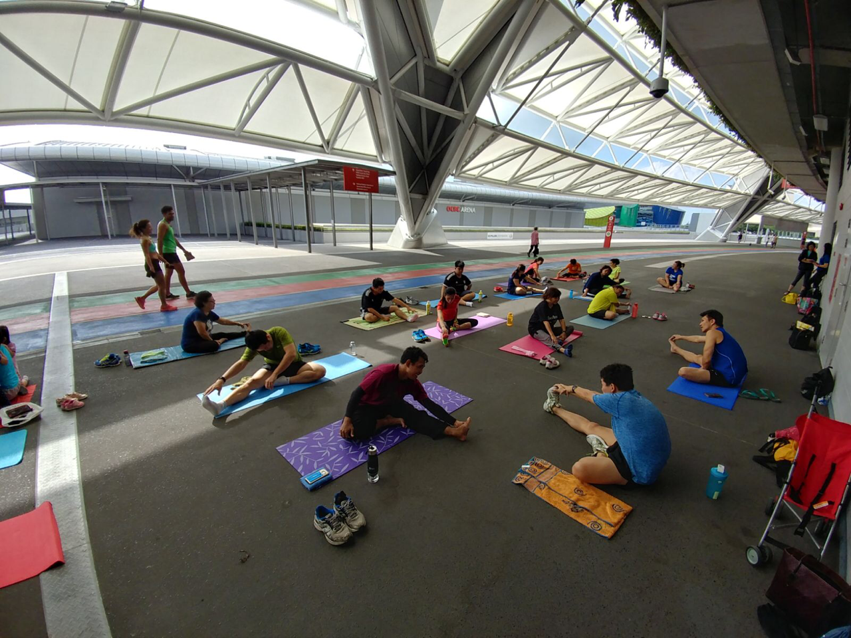
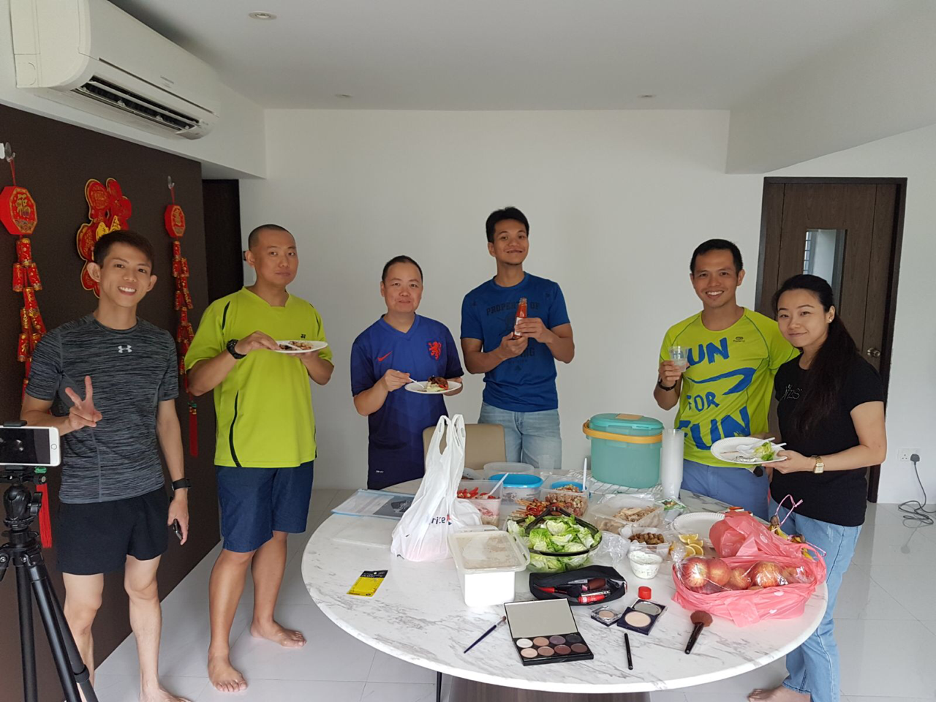
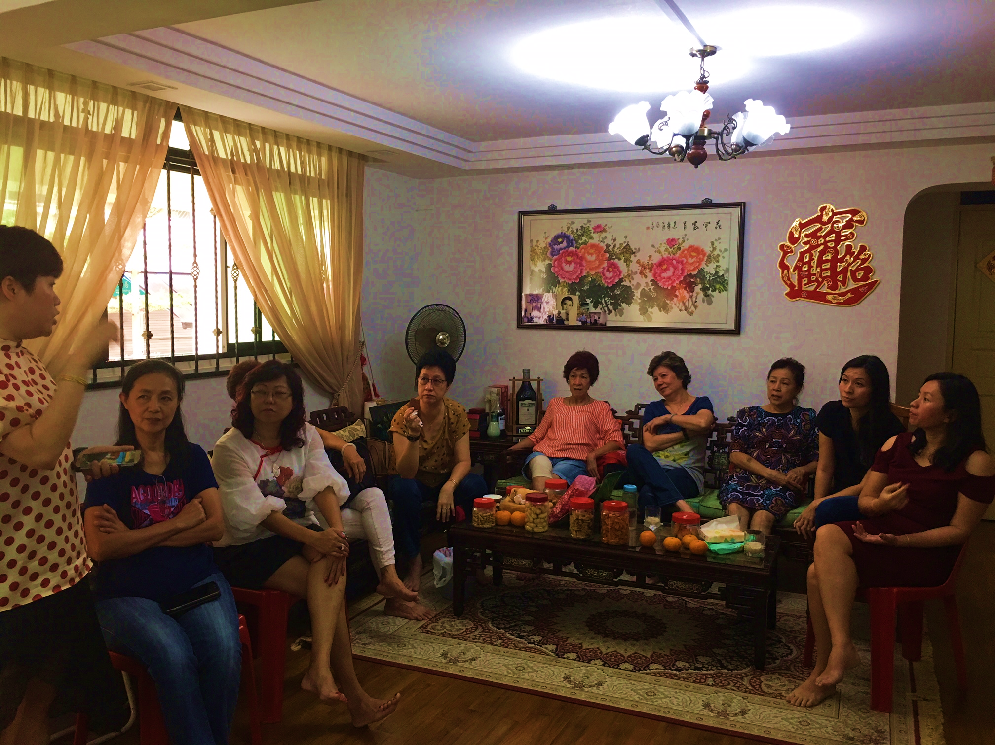

Slide 24
